Slide 1

Intelligent Complaint Redressal and Public Service Monitoring Portal
Course Name :Java Programming
Course Code :CSA0905
By
Y. Praneeth (192372269)
R. Udaya simha reddy (192372070)
Natesa krishnan V (192511311)
Guided by
Dr. Sivasankar C

Slide 2


Introduction
The Intelligent Complaint Redressal and Public Service Monitoring Portal is a Java-based application designed to manage public complaints efficiently.
It provides a centralized platform where citizens can register complaints related to public services such as water supply, electricity, roads, sanitation, and other government departments.
The system assigns a unique complaint ID to every complaint, making it easy to identify and track.
Users can monitor the status of their complaints through different stages, including Pending, In Progress, and Resolved.
The portal improves transparency by allowing citizens to view the progress of their complaints.
It helps government departments respond to complaints quickly and efficiently, reducing delays in service delivery.

Slide 3
Objectives
To develop a centralized system for registering and managing public complaints efficiently.
To provide citizens with an easy and user-friendly platform to submit complaints related to public services.
To generate a unique complaint ID for each complaint to enable easy identification and tracking.
To allow users and administrators to monitor the status of complaints from registration to resolution.
To improve transparency by providing real-time updates on complaint progress.
To reduce manual paperwork and simplify the complaint handling process through automation.
To help government departments resolve complaints quickly and improve service quality.
To maintain accurate records of complaints for future reference and reporting.

Slide 4
Problem statement
Traditional public complaint systems are often manual, making the complaint registration and resolution process slow and inefficient.
Citizens face difficulties in tracking the status of their complaints, resulting in a lack of transparency and trust.
Manual record management can lead to misplaced documents, duplicate complaints, and data entry errors.
Delays in assigning and resolving complaints reduce the overall quality of public services.
Government departments often lack a centralized system to monitor complaints across different service areas.
Without proper monitoring, it is difficult to measure departmental performance and identify unresolved complaints.
The absence of real-time complaint status updates causes communication gaps between citizens and authorities.

Slide 5
Literature survey
S. No. | Author(s) | Year | Paper Title | Key Findings | Research Gap
1 | Victoria Anthony Uwah et al. | 2024 | Online Complaint Management System | Enables online complaint registration and tracking. | No performance dashboard.
2 | Hanad Mohamud Mohamed et al. | 2025 | Automated Complaint Management using ML and NLP | Uses AI to classify complaints automatically. | Limited public service monitoring.
3 | Catalina Sierra et al. | 2025 | LLM-Based Complaint Management System | Improves complaint processing using AI. | Requires advanced AI infrastructure.
4 | Dr. C. Nandini et al. | 2025 | Web-Based Complaint Management System | Enhances transparency and faster complaint resolution. | Lacks intelligent analytics.
5 | IEEE Research Team | 2025 | Public Grievance Redressal System | Supports complaint tracking and monitoring. | No detailed performance dashboard.

Slide 6
Modules
Module 1. Complaint Registration
Module 2. Resolution Tracking
Module 3. Performance Dashboard Module

Slide 7
Existing vs Proposed system
Existing System | Proposed System
Manual complaint registration through paper forms or office visits. | Online complaint registration through a Java-based application.
Citizens cannot easily track the status of their complaints. | Real-time complaint status tracking (Pending, In Progress, Resolved).
Complaint records are maintained manually, leading to delays and errors. | Digital storage of complaint records for quick access and management.
No centralized system for managing complaints from multiple departments. | Centralized complaint management for different public service departments.
Limited transparency in the complaint resolution process. | Provides transparent complaint tracking and regular status updates.
No dashboard to monitor complaint statistics and department performance. | Performance dashboard showing total, pending, in-progress, and resolved complaints.

Slide 8
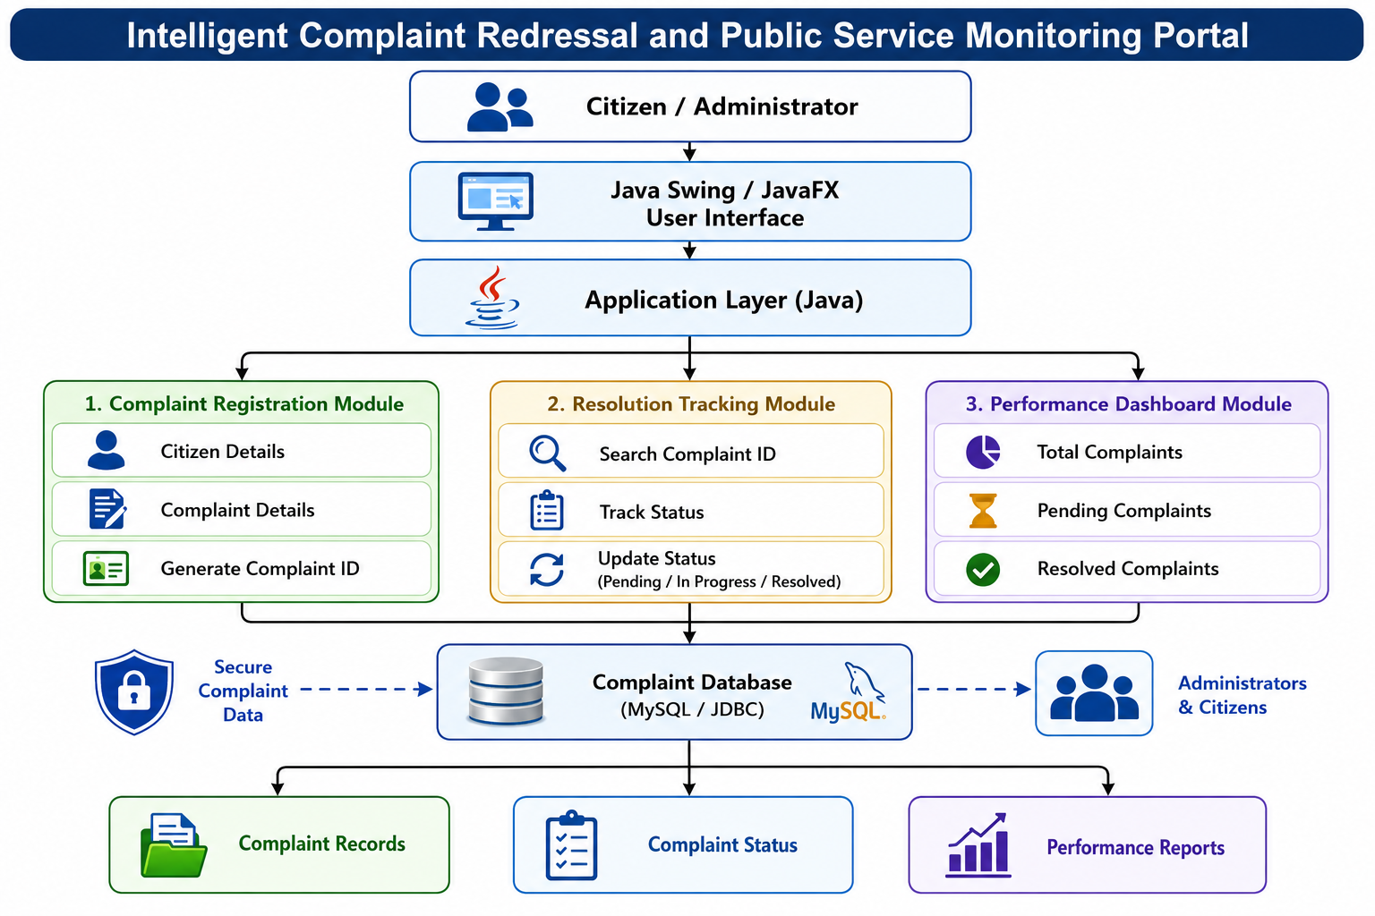
System Architecture

Slide 9
Conclusion
The system improves transparency by providing real-time updates on complaint progress.
The Resolution Tracking Module helps administrators manage and resolve complaints efficiently.
The Performance Dashboard Module provides useful statistics for monitoring departmental performance and service quality.
The project reduces manual paperwork, minimizes delays, and improves the overall complaint management process.
Developed using Java and Object-Oriented Programming (OOP) concepts, the system is reliable, user-friendly, and easy to maintain.

Slide 10
Future Scope
Develop the portal as a web and mobile application for easier access by citizens.
Integrate AI-based complaint classification to automatically categorize complaints by department.
Implement SMS and email notifications to provide real-time updates on complaint status.
Add GPS/location-based complaint reporting with photo uploads for accurate issue identification.
Introduce priority-based complaint handling for emergency and critical public service issues.

Slide 11
THANK YOU

Slide 12
